Slide 1

HOSPITAL OPERATIONAL REVIEW
Optimizing City General Hospital Control
Mayowa Adeboye
Data Analyst

Slide 2

Resource Misalignment: Capacity mismatch (e.g., preparing beds for teenagers while seniors dominate visits).
Quality Crisis: High rate of inconclusive lab test results (35% confirmed) leading to delays.
Staffing/Billing: Uneven doctor workload and potential financial leakage from low-paying insurance providers.
Inventory Risk: Running out of high-demand drugs while low-demand drugs expire.
Problem Summary

Slide 3

Objective of the Analysis
Optimize Resource Allocation: Align capacity (beds, equipment) with actual patient demographics.
Pinpoint Quality Failure: Identify the primary source (Hospital) of inconclusive test results.
Improve Operational Efficiency: Balance staff workload and predict emergency spikes for better scheduling.
Mitigate Financial/Inventory Risk: Identify underpaying insurance providers and optimize medication stock.

Slide 4
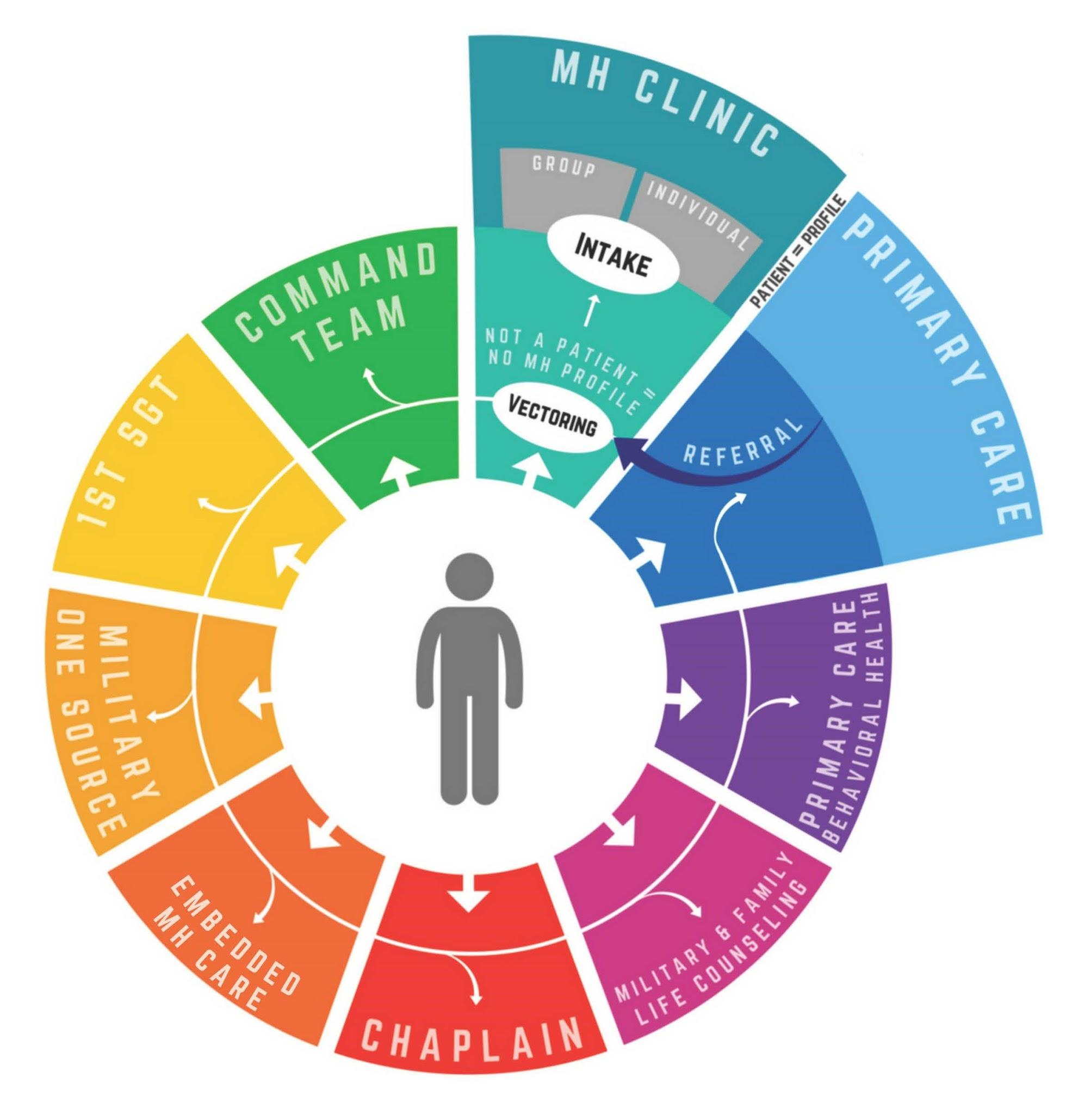
Data Overview
Data Source: City Hospital Dataset (Patient Demographics, Admissions, Billing, Test Results).
Key Columns Used: Age, Gender, Date of Admission, Hospital, Doctor, Insurance Provider, Test Results.
Data Preparation: Creation of new fields like 'Age Group', 'Day of Week'.

Slide 5
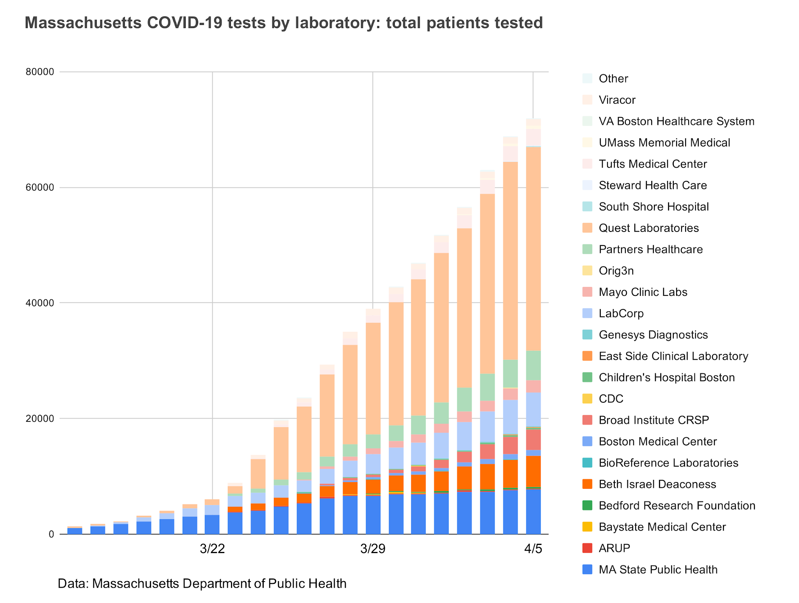
Key Metrics (KPIs)
Total Patients Analyzed: 55,500 Admissions.
Total Number of Doctors: 40,341 Unique Physicians.
Workload Imbalance: The busiest doctor handles 20 times the average patient workload, demanding immediate schedule balancing.

Slide 6
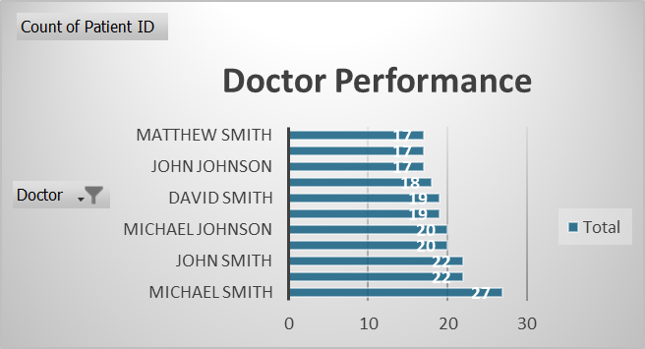
Dashboard Insights 1
Resource Alignment & Staffing
Seniors (>_ 65$) are the top demographic, justifying an immediate shift in bed configuration.
Workload is highly imbalanced; the Busiest Doctor handles 20 times the average patient load, demanding immediate schedule relief.
Objective title

Slide 7
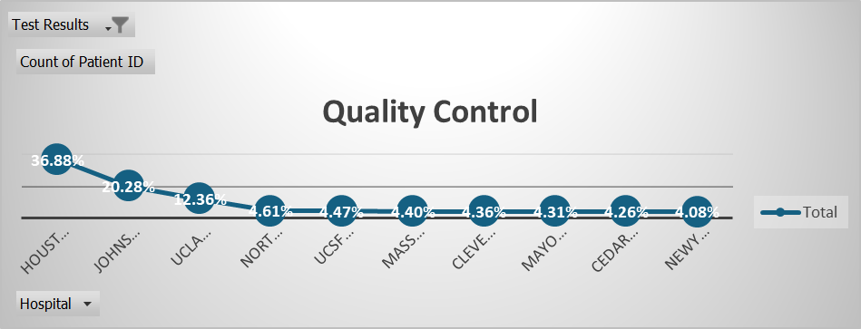
Dashboard Insights 2
Quality Control Crisis
The 35% Inconclusive Test Rate is a major quality failure driving delays and costs.
The problem is pinpointed to Houston Methodist Hospital and Johns Hopkins Hospital, which are the highest contributors of bad results.

Slide 8
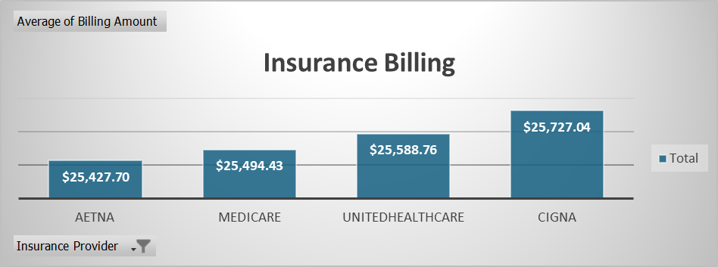
Dashboard Insights 3
Financial & Inventory Risk
The average payment from Aetna is significantly lower, flagging a financial leakage point.
High-demand essential drugs require higher safety stock, while low-demand drugs are at risk of expiration.

Slide 9

Deep Dive: Emergency Spikes
Consistent, predictable emergency spikes occur on Tuesday.
Staffing and resource allocation should be dynamically increased on Tuesdays to prevent ER congestion.

Slide 10

Summary of Findings
Resource Shift is Critical: Reallocate capacity to Senior-focused beds as they are the primary demographic.
Quality Failure is Localized: Houston Methodist Hospital and Johns Hopkins Hospital are the top sources of the 35% Inconclusive Test Rate.
Workload is Uneven: The busiest doctor handles approximately 20 times the average workload, requiring immediate shift balancing.
Financial Audit Required: The insurance provider Aetna requires an audit due to the lowest average billing amount.

Slide 11

Recommendations
ACTION 1: Resource Reallocation. Formalize the capacity shift to Senior-focused beds and equipment immediately to align with the dominant patient group.
ACTION 2: Quality Control Intervention. Dispatch an engineering team to Houston Methodist Hospital and Johns Hopkins Hospital within 48 hours to address machine failure, correcting the $35\%$ inconclusive rate.

Slide 12
Recommendations
ACTION 3: Scheduling Optimization. Mandate a review of the physician scheduling model, prioritizing higher staffing on Tuesdays to prevent ER congestion.
ACTION 4: Financial Audit. Initiate a contract and billing review specifically targeting the insurance provider Aetna.

Slide 13
Short Briefing
Conclusion
With this dashboard, we now understand where the hospital is losing control and how to fix it.
Call To Action
Request: Immediate approval to form an Implementation Task Force.

Slide 14
Thank you

